Slide 1
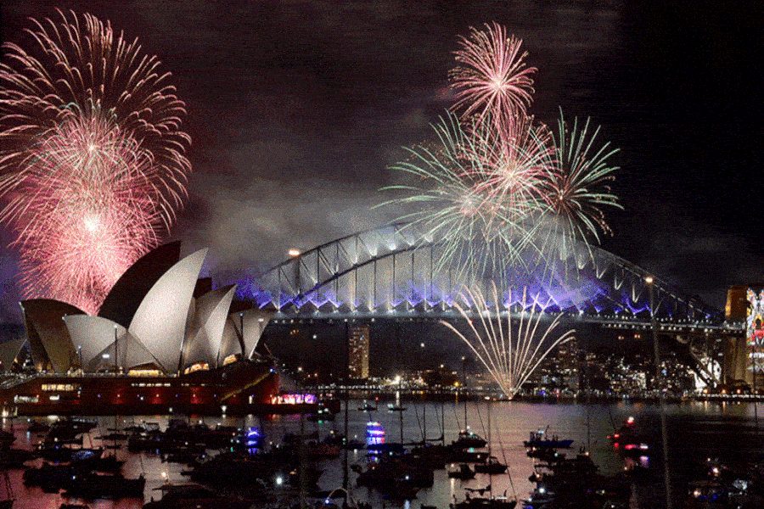
How to say “跨年” in English?
celebrate New Year’s Eve

Slide 2
attend New Year’s Eve celebrations 參加跨年活動
watch the fireworks 看煙火
go to a concert 聽演唱會
listen to live music 聽現場音樂
dance the night away 跳舞跳通霄
go to a party 參加派對
go on a trip 去旅行
have a supper 吃一頓大餐
be a couch potato 窩在家裡
stay up late 熬夜

Slide 3
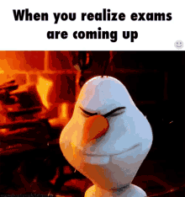
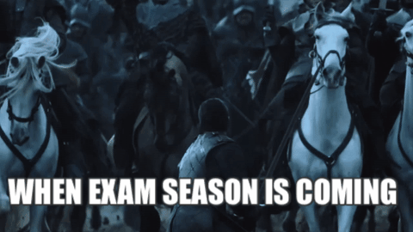

Slide 4
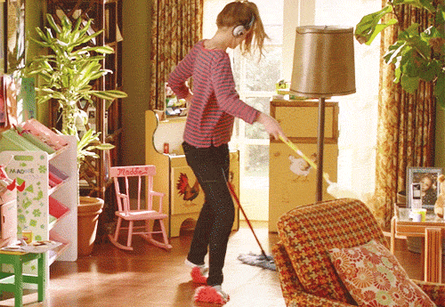
cleaned the room
clean the room
〔d〕

Slide 5
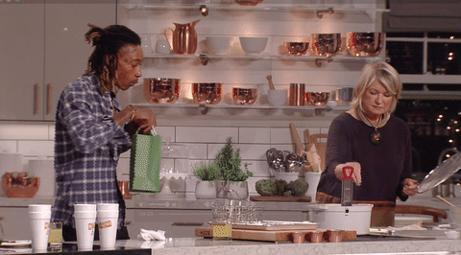
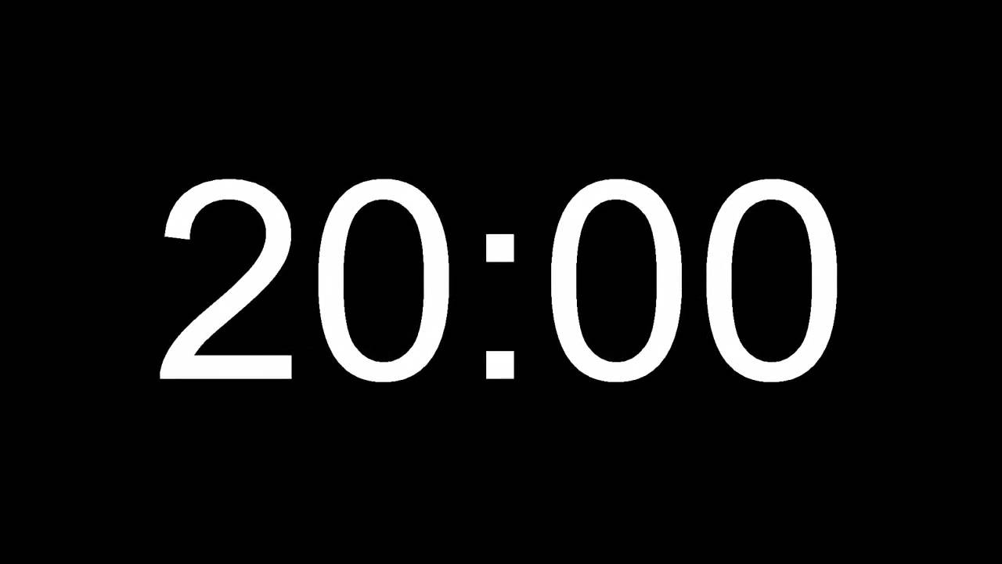
cooked dinner
cook dinner
〔t〕

Slide 6
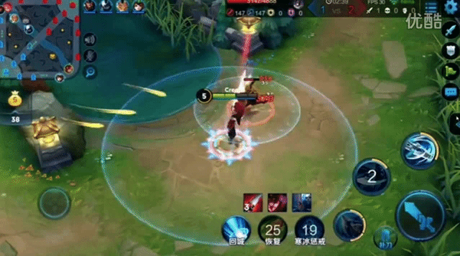
play on-line games
played on-line games
〔d〕

Slide 7
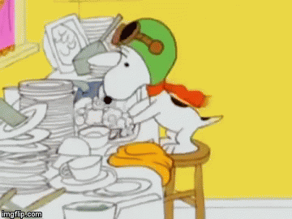
washed the dishes
wash the dishes
〔t〕

Slide 8
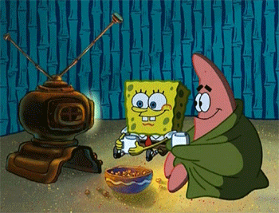
watch a movie
watched a movie
〔t〕

Slide 9
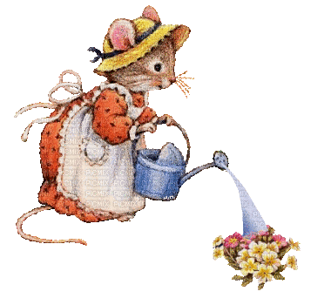
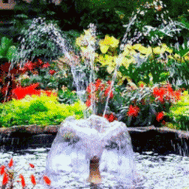
water the flowers
watered the flowers
〔d〕

Slide 10
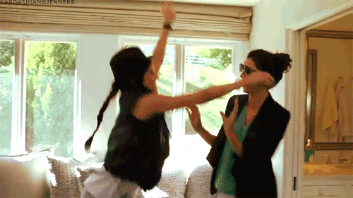
visit a friend
visited a friend
〔Id〕

Slide 11
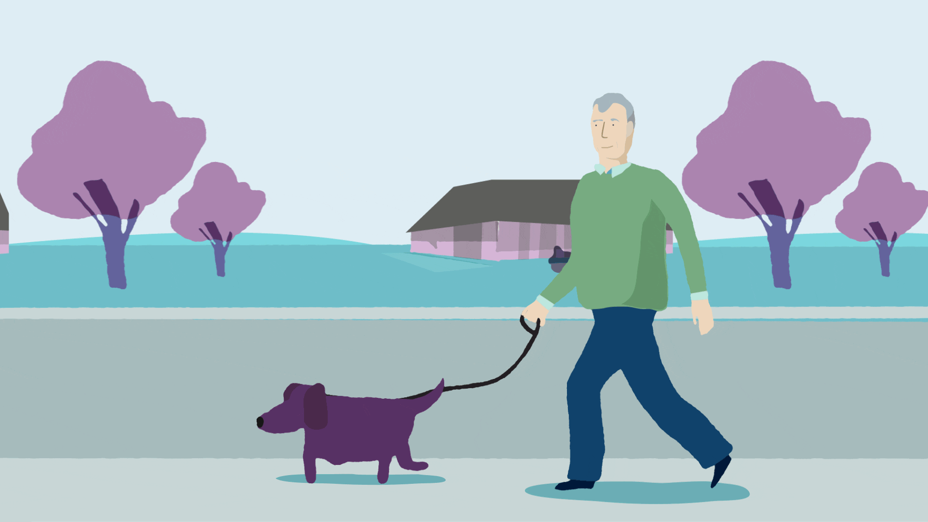
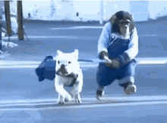
walked the dog
walk the dog
〔t〕

Slide 12
listened to music
listen to music
〔d〕

Slide 13
surfed the Internet
surf the Internet
〔t〕

Slide 14
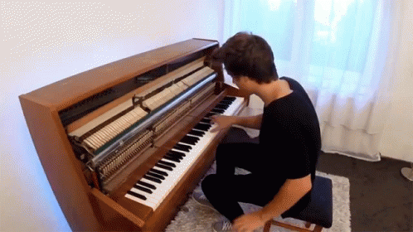
played the piano
play the piano
〔d〕

Slide 15
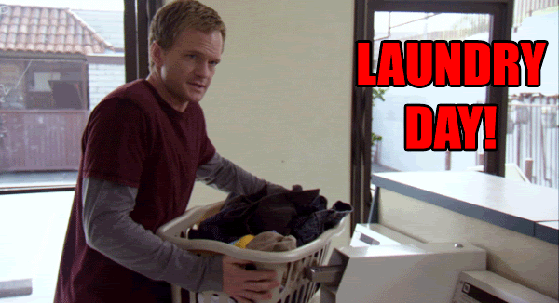
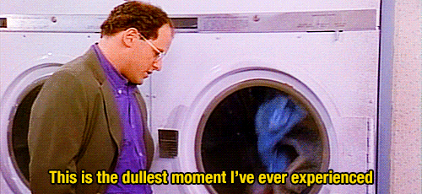
did the laundry
do the laundry

Slide 16
Did you clean the room yesterday?
Didn’t也是照妖鏡
過去式助動詞
照妖鏡→ 把動詞打回原形
cleaned → clean

Slide 18
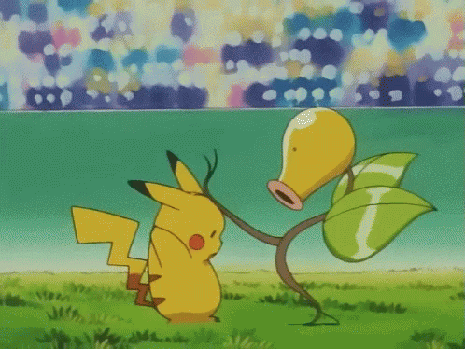
Let’s K.O. the Workbook!!!!

Slide 20
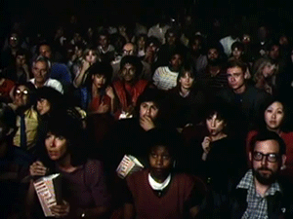
Michael Jackson ( saw / watched)
a ______ last Friday.

Slide 21
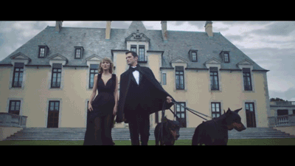
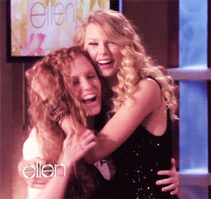
Taylor Swift _____ the ________ and
______ a ________ last year.

Slide 22
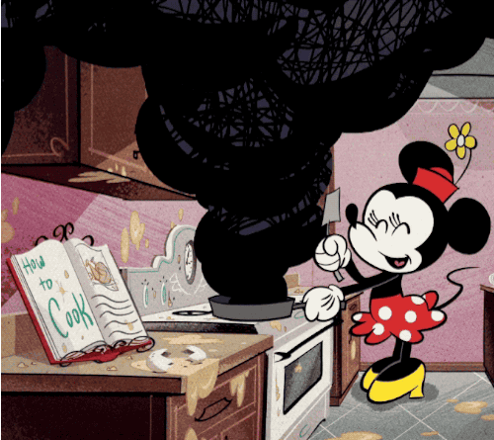
Mickey ______ _____ _________,and
Minnie ______ (dinner/late night meal) last night.

Slide 23
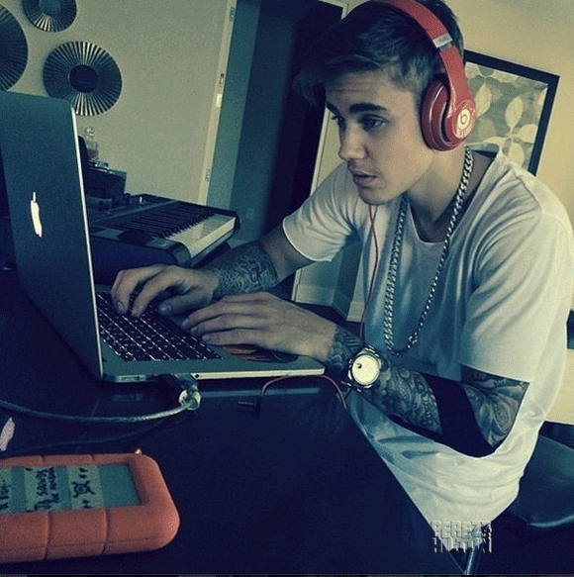
Justin Bieber didn’t ________ to _________, but he ______ the ________ yesterday.

Slide 24
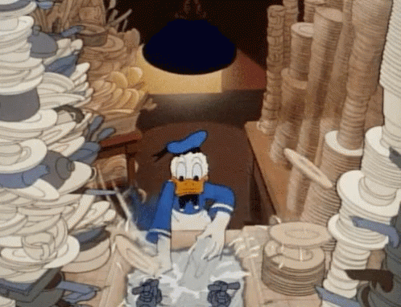
Do they (clean/ cleaned) the room on Mondays?
No, they don’t. They _______ the ________ on Mondays.

Slide 25
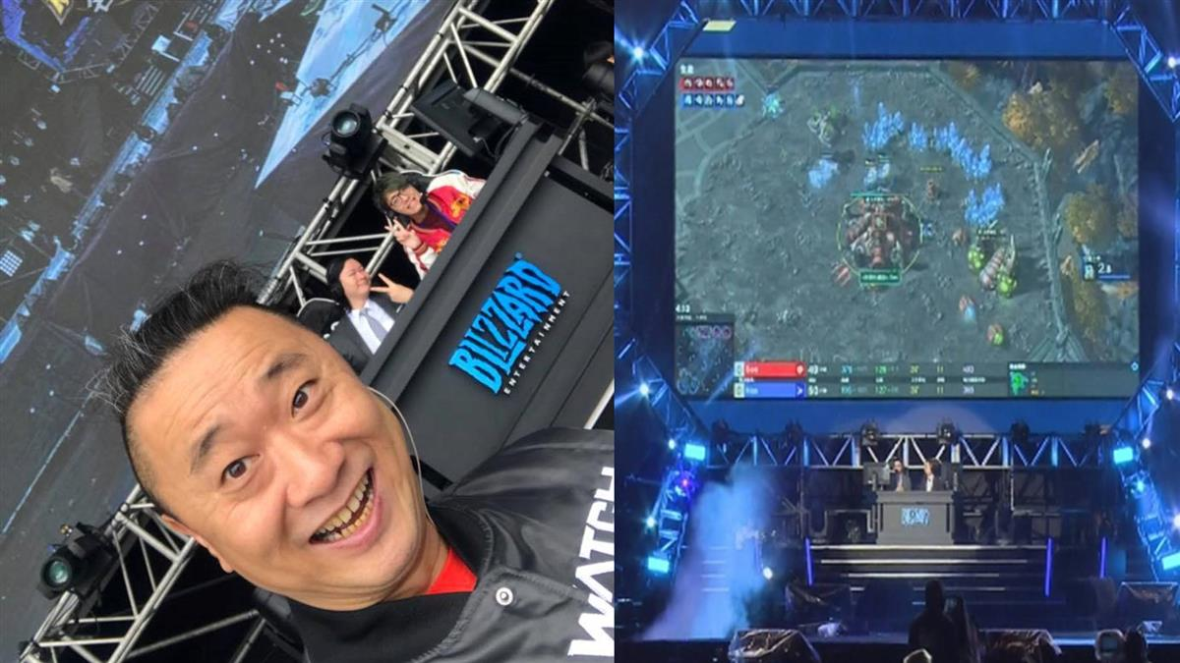
Did he (water/ watered) the flowers few days ago?
No, he didn’t. He _______ ________ games few days ago.

Slide 26
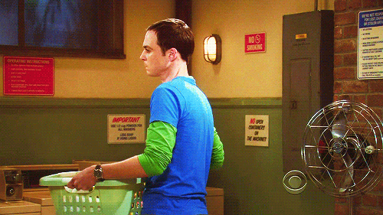
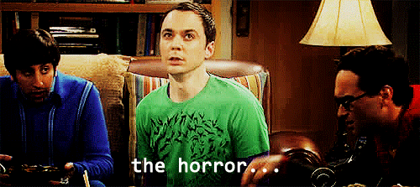
Sheldon doesn’t like to do the _______
at all.

Slide 27
Which “ed” sound is different?
played
opened
wanted

Slide 28
Which “ed” sound is different?
landed
talked
painted

Slide 29
Which “ed” sound is different?
called
washed
cooked

Slide 30
Exchange your test books!!!!

Slide 31
1. saw/ movie
2. walked/ dogs/ visited/ friend
3. played/ the/ piano/ cooked/ late night meal
4. listen/ music/ surfed/ Internet
5. clean/ wash/ dishes
6. water/ played/ on-line
7. laundry
8. wanted
9. talked
10. called
一格一格改
每格4分，
錯一個字母扣1分

Slide 32
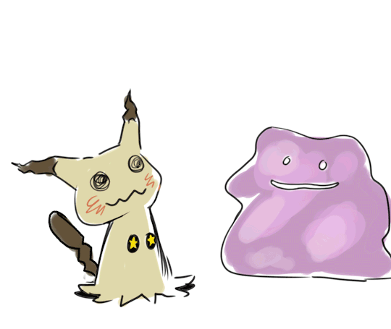
【本週英語作業】
準備1/10(四)的英語期末考。
範圍: Unit1~Unit4單字(要熟背)
+句型(正確問答&詳答)、
各課phonics(熟悉發音規則)、
生活會話(聽力&閱讀測驗)

